Slide 1

A Language Processing System

Slide 2
Course scope
Aim:
To learn language processing system,Overview of Assembler, Interpreter,Compiler etc.
Main reference:
Compilers – Principles, Techniques and Tools, Second Edition by Alfred V. Aho, Ravi Sethi, Jeffery D. Ullman.
Compiler Design- Dr.R. Venkatesh

Slide 3
Module -I Introduction to LPS
Computer system is made of hardware and software.
The hardware understands a language, which humans cannot understand.
So we write programs in high-level language, which is easier for us to understand and remember.
These programs are then fed into a series of tools and OS components to get the desired code that can be used by the machine.
This is known as Language Processing System.

Slide 4
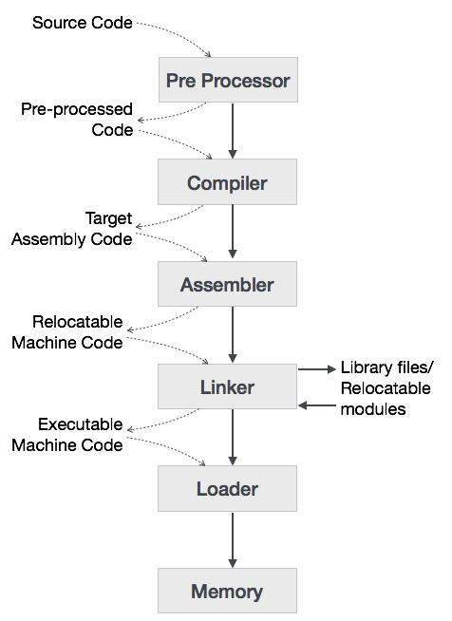
Fig.1: Language Processing System diagram
Reference: Txt bk compiler design, Page 8.

Slide 5
Preprocessor
A preprocessor produce input to compilers. They may perform the following functions.
1. Macro processing: A preprocessor may allow a user to define macros that are short hands for longer constructs.
2. File inclusion: A preprocessor may include header files into the program text.
3. Rational preprocessor: these preprocessors augment older languages with more modern flow-ofcontrol and data structuring facilities.
4. Language Extensions: These preprocessor attempts to add capabilities to the language by certain amounts to build-in macro

Slide 6
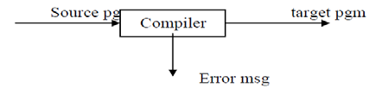
Compiler
Compiler is a translator program that translates a program written in (HLL) the source program and translate it into an equivalent program in (MLL) the target program.
As an important part of a compiler is error showing to the programmer.
Fig 1.2 Structure of compiler

Slide 7
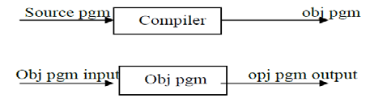
Executing a program written n HLL programming language is basically of two parts. the source program must first be compiled translated into a object program.
Then the results object program is loaded into a memory executed.
Fig 1.3 Execution process of source program in compiler

Slide 8
Assembler
Programmers found it difficult to write or read programs in machine language. They begin to use a mnemonic (symbols) for each machine instruction, which they would subsequently translate into machine language.
Such a mnemonic machine language is now called an assembly language.
Assembler converts assembly language into object language

Slide 9
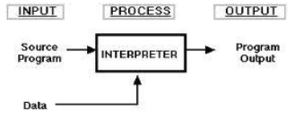
Interpreter
An interpreter is a program that appears to execute a source program as if it were machine language.
Languages such as BASIC, SNOBOL, LISP can be translated using interpreters. JAVA also usesinterpreter. The process of interpretation can be carried out in following phases.
1. Lexical analysis
2. Synatx analysis
3. Semantic analysis
4. Direct Execution
Fig.1.4 Execution in Interpreter

Slide 10
Loader and Link editor
A loader is a program that places programs into memory and prepares them for execution. It would be more efficient if subroutines could be translated into object form the loader could ”relocate”directly behind the user’s program.
The task of adjusting programs they may be placed in arbitrary core locations is called relocation.

Slide 11
Translator
A translator is a program that takes as input a program written in one language and produces as output a program in another language.
Beside program translation, the translator performs another very important role, the error-detection.
Any violation of the HLL specification would be detected and reported to the programmers.
Important role of translator are:
1. Translating the HLL program input into an equivalent ml program.
2. Providing diagnostic messages wherever the programmer violates specification of the HLL.

Slide 12
LIST OF COMPILERS
1. Ada compilers
2 .ALGOL compilers
3 .BASIC compilers
4 .C# compilers
5 .C compilers
6 .C++ compilers
7 .COBOL compilers
8 .Common Lisp compilers
9. ECMAScript interpreters
10. Fortran compilers
11 .Java compilers
12. Pascal compilers
13. PL/I compilers
14. Python compilers
15. Smalltalk compilers

Slide 13
THANK YOU.
ANY QUESTIONS????

